Slide 1
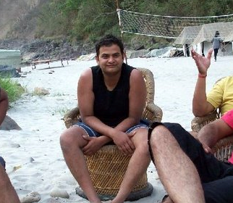
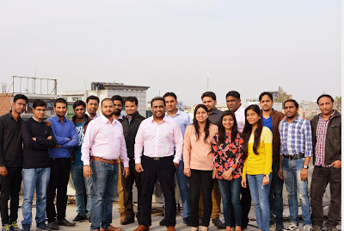
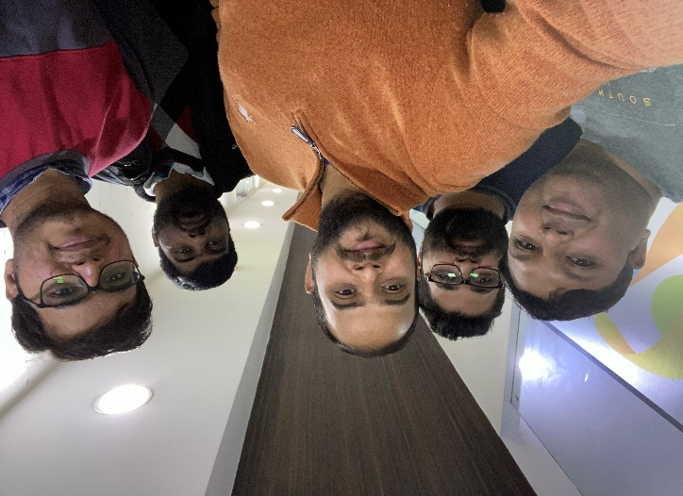
YEAR 2007 (year of your joining)
YEAR 2017 (Any special picture of you – at your workplace)
My Experience with Omnie…
SINCE OCT 2007 (Since your Year of joining)
The 12 years of my life spent at Omnie Solutions and counting many more to come, I have got a fantastic mentor (VJ), great teams and friends. It is from all of them that I have learnt a lot, started to enjoy my work and I wish the same thing in future too.
YEAR 2020

